Slide 1
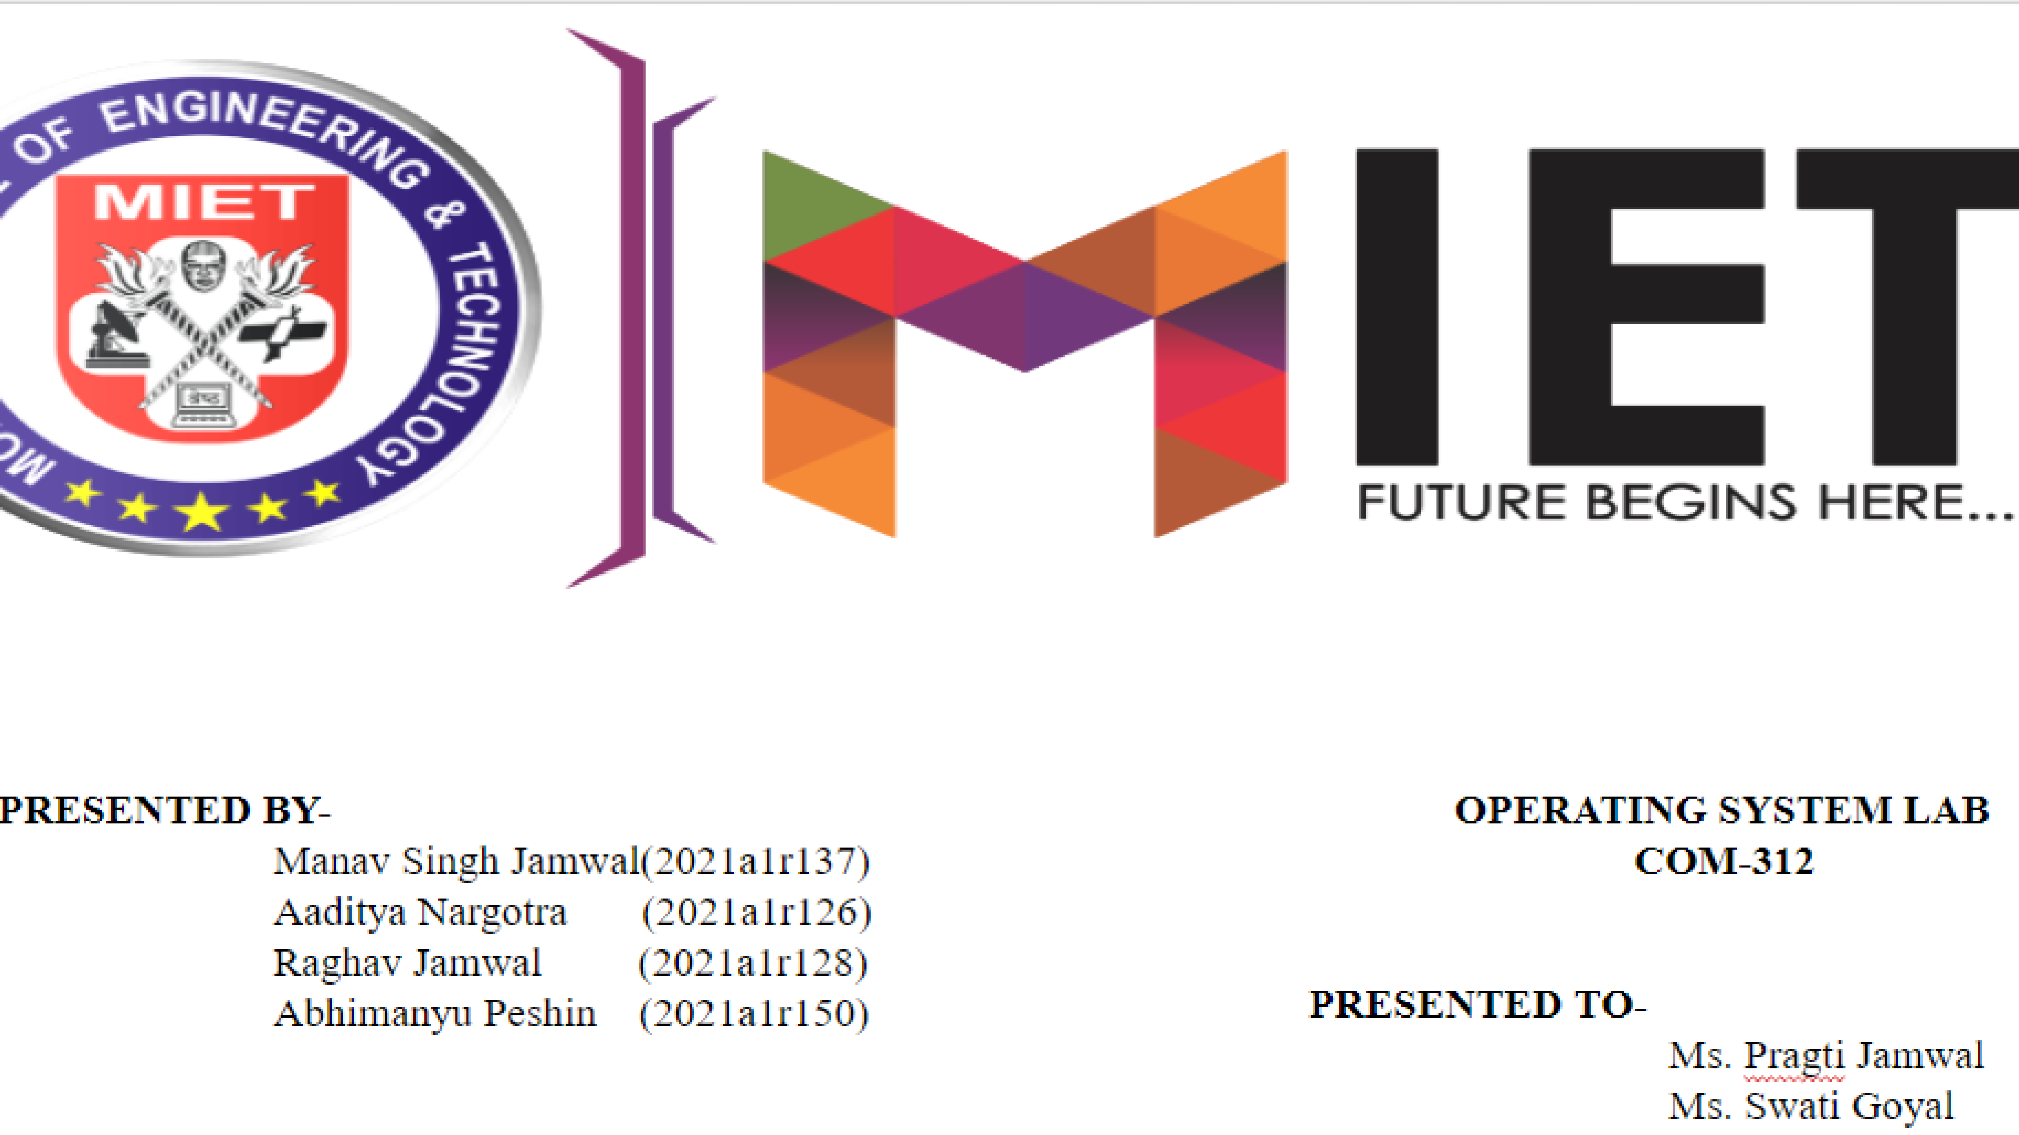

Slide 2
PRESENTATION
DEADLOCK DETECTION

Slide 3



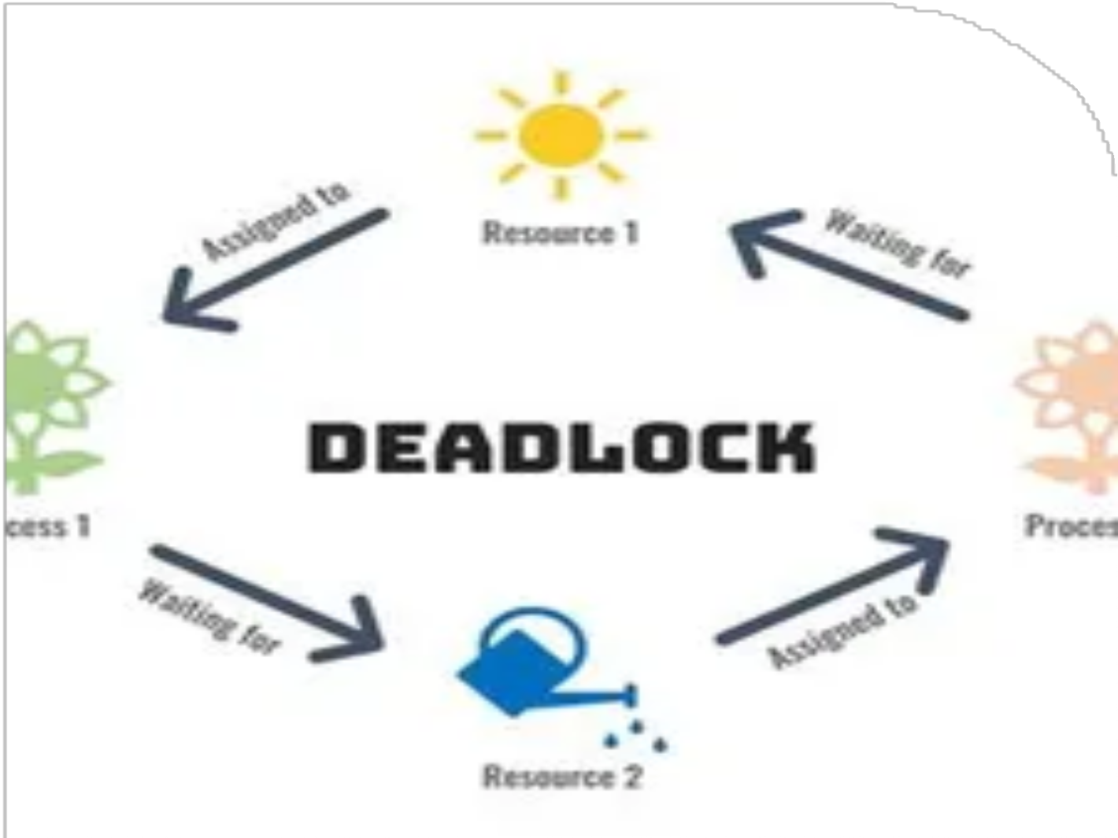

WHAT IS A
DEADLOCK
STUDIO SHODWE

Slide 4





DEADLOCK
A deadlock is a situation in which two computer programs sharing the same resource are effectively preventing each other from accessing the resource, resulting in both programs ceasing to function
2022 PRESENTATION

Slide 5
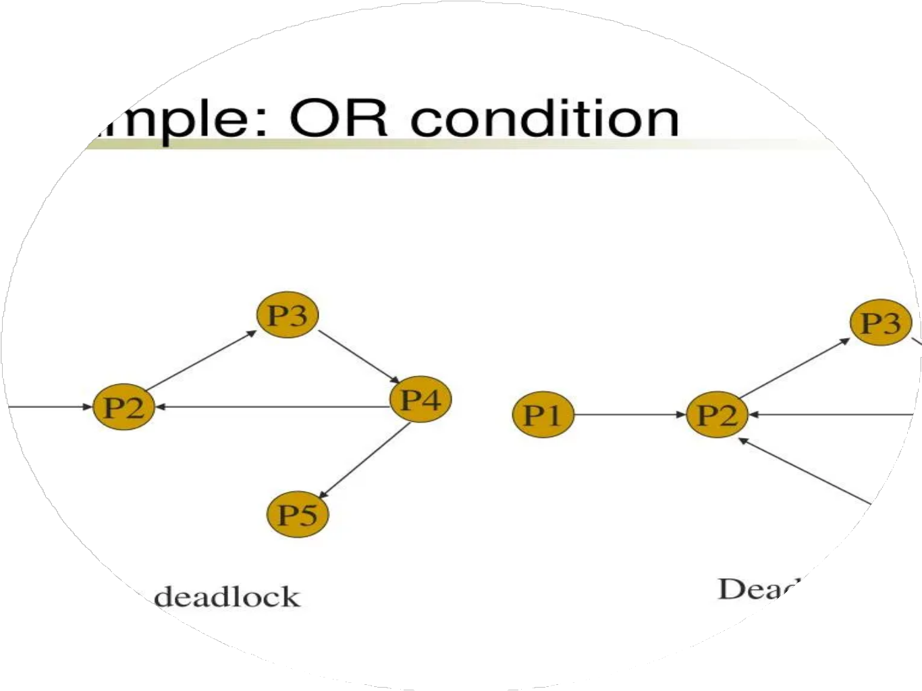

WHAT IS
DEADLOCK DETECTION
Description Here
Deadlock Detection monitors the driver's use of resources which need to be locked -- spin locks, mutexes, and fast mutexes. This Driver Verifier option will detect code logic that has the potential to cause a deadlock at some future point
2022 PRESENTATION

Slide 6
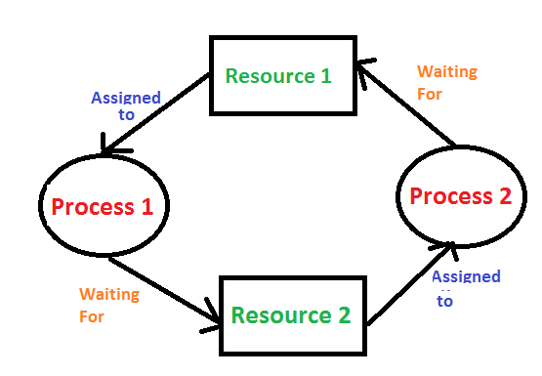


DEADLOCK DETECTION
IF RESOURCES HAVE SINGLE INSTANCE
In this case for Deadlock detection, we can run an
algorithm to check for the cycle in the Resource Allocation Graph. The presence of a cycle in the graph is a sufficient condition for deadlock.
2022 PRESENTATION

Slide 7
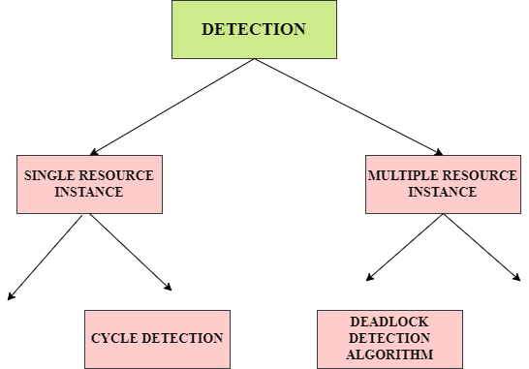
FLOW CHART

Slide 8
Steps of Algorithm:
Let Work and Finish be vectors of length m and n respectively. Initialize Work= Available. For i=0, 1, …., n-1, if Requesti = 0, then Finish[i] = true; otherwise, Finish[i]= false.
Find an index i such that both
Finish[i] == false
Requesti <= Work
If no such i exists go to step 4. Work= Work+ Allocationi Finish[i]= true
Go to Step 2.
If Finish[i]== false for some i, 0<=i<n, then the system is in a deadlocked state. Moreover, if Finish[i]==false the process Pi is deadlocked.

Slide 9

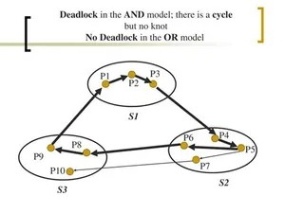
If there are multiple instances of resources –
Detection of the cycle is necessary but not sufficient condition for deadlock detection, in this case, the system may or may not be in deadlock varies according to different situations.
2022 PRESENTATION

Slide 10
TYPES OF MULTIPLE
DEADLOCK'S RECOVERY
Killing the process –
Killing all the processes involved in the deadlock. Killing process one by one. After killing each process check for deadlock again keep repeating the process till the system recovers from deadlock. Killing all the processes one by one helps a system to break circular wait condition.
Resource Preemption –
Resources are preempted from the processes involved in the deadlock, preempted resources are allocated to other processes so that there is a possibility of recovering the system from deadlock. In this case, the system goes into starvation.
2022 PRESENTATION

Slide 11


THANK YOU
2022 PRESENTATION

